Slide 1

UE23CS320B – Capstone Project Phase – 2
Project Progress Review #1
Project Title : Detecting Depression using vocal cues Project ID : PW26_CBH_04
Project Guide : Ms. Chandravva Hebbi
Project Team : Vishruth Rallapalli, Yuvraj Rao,
Vivan Jeevan Naik, Srujan J

Slide 2
Detecting Depression using vocal cues
Outline
Proposed System Architecture
Dataset and Pre-processing
Feature Extraction and Processing
Modelling and Prediction
Literature survey
Audio Pre-processing and Feature Extraction Approach 1
Audio Pre-processing and Feature Extraction Approach 2
Method-1 vs Method-2: Feature Extraction & Modeling Strategy
References

Slide 3
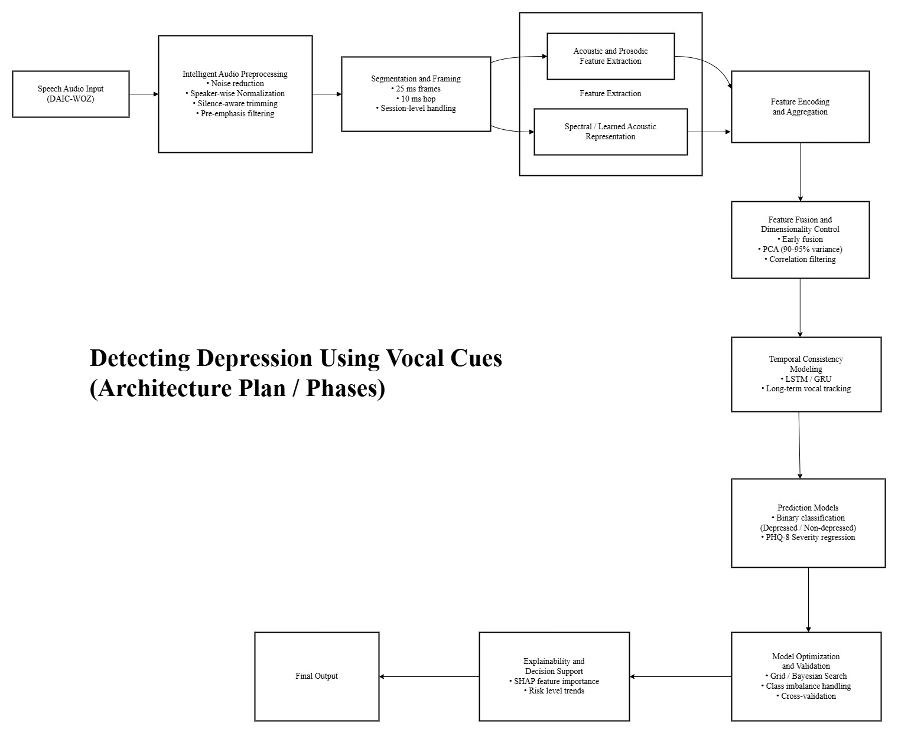
Detecting Depression using vocal cues
Proposed System Architecture

Slide 4
Detecting Depression using vocal cues
Proposed System Architecture
POINTERS:
Our system follows a layered and modular pipeline for detecting depression from speech.
Inspired by the AVEC framework and recent research studies.
Converts raw voice input into meaningful mental health predictions.
Designed to be scalable, flexible, and device-independent.
Supports multiple processing and modeling approaches.
MAIN STAGES:
Audio Collection
Pre-processing
Feature Extraction
Feature Fusion
Modeling
Prediction
Explainability

Slide 5
Detecting Depression using vocal cues
Dataset and Pre-processing
DATASET USED:
We use the DAIC-WOZ dataset (AVEC Standard Dataset).
Contains clinical interview recordings.
Widely used in depression detection research.
AUDIO PRE-PROCESSING
Purpose: Prepare clean and usable speech data.
COMMON STEPS:
Silence removal
Noise reduction
Volume normalization
Audio segmentation
DUAL PROCESSING APPROACHES
Approach 1: Librosa + AVEC Method
Customized preprocessing
Used for experimental control
Approach 2: OpenSMILE Framework
Standardized feature extraction
Robust and widely validated

Slide 6
Detecting Depression using vocal cues
Feature Extraction and Processing
FEATURE EXTRACTION:
We extract speech characteristics related to mental state
MAIN FEATURES:
MFCC
Pitch
Energy
Speaking rate
Spectral features
Voice quality features(Based on AVEC and recent studies)
FEATURE PROCESSING:
Purpose: Make features suitable for modeling.
Normalization
Noise feature removal
Dimensionality reduction (PCA)
Statistical aggregation
Feature Fusion
Combines outputs from Librosa and OpenSMILE pipelines.
Forms a unified feature vector.

Slide 7
Detecting Depression using vocal cues
Modeling and Prediction
MODEL SELECTION IS BASED ON:
Dataset size
Stability
Validation performance
PRIMARY MODEL (BASELINE)
Support Vector Machine (SVM):
Reliable for small to medium datasets
Good generalization
Alternative Models (If Required):
Random Forest
XGBoost
Logistic Regression
CNN / LSTM (with larger data)
EXPLAINABILITY:
Feature importance analysis
Interpretable predictions
Clinically meaningful insights
Supports real-world use.
TRAINING & OPTIMIZATION:
To improve performance:
Chunk-based training
Cross-validation
Hyperparameter tuning
Overfitting control
Ensures stable learning.
PREDICTION & EVALUATION
Output:
  Depressed / Non-Depressed
Metrics:
Accuracy
Precision
Recall
F1-Score
AUCCompared with AVEC baselines.

Slide 8
Detecting Depression using vocal cues
Literature Review – Study I
PAPER: "DIAGNOSTIC ACCURACY OF TRADITIONAL VS. DEEP LEARNING METHODS" (BMC PSYCHIATRY, 2025).
Scope: Systematic review of 25 studies involving 700,000+ speech samples.
COMPARISON TO AVEC STANDARDS:
While AVEC (2016) established TML baselines, this 2025 study found that Deep Learning (specifically Traditional CNNs) offers a marginal accuracy increase (AUC 0.91) over Traditional Machine Learning (AUC 0.89).
The Catch: Deep Learning models require massive datasets ( N>500 subjects) to avoid overfitting.
Validation of Our Approach (Small Data Strategy):
Sample Size Impact: The study proved that TML (our approach) sees a significant specificity jump (0.76 → 0.87) once samples exceed 100.
OUR APPLICATION: By segmenting our single audio file into 106 chunks, we artificially met this stability threshold.
Architecture Finding: "Traditional CNNs" outperformed "Advanced/Complex CNNs" (AUC 0.94 vs 0.89).Lesson: Simpler is better. With limited data, complex models fail. This validates our decision to stick to robust feature extraction (OpenSMILE) rather than a heavy Neural Network.
CLINICAL RECOMMENDATION:
The authors propose a Hierarchical Framework:
Primary Screening (Apps/Mobile): Use TML (OpenSMILE) for efficiency and interpretability.
Hospital Confirmation: Use Deep Learning where high computing power is available.
Conclusion: Our project is perfectly aligned with the "Primary Screening" use case.

Slide 9
Detecting Depression using vocal cues
Literature Review – Study II
  PAPER: "EVALUATION OF AN AI-BASED VOICE BIOMARKER TOOL" (ANNALS OF FAMILY MEDICINE, 2024).
Scope: Large-scale study (N=14,898) on depression detection using personal devices.
MODEL APPROACH & PRE-PROCESSING:
Input Strategy: Unlike standard datasets that use long clinical interviews, this model analyzed 25-second free-form voice clips (Prompt: "How was your day?").
Pre-processing: Focused on device-agnostic capture (recorded via personal smartphones/laptops). This implies the model—and any pre-processing—was designed to handle high variability in microphone quality and background noise, rather than requiring studio conditions.
COMPARISON TO AVEC STANDARDS:
Workflow Efficiency: AVEC/DAIC-WOZ benchmarks rely on 15–20 minute structured interviews. Mazur demonstrates that short-duration speech (<30s) contains sufficient biomarkers for detection (Sensitivity: 71.3%).
KEY TAKEAWAY FOR OUR MODEL:
Mazur found significant performance drops in male subjects (59% sensitivity vs 74% female).Next Step: We should incorporate gender-specific thresholds into our OpenSMILE classifier to avoid this known bias.

Slide 10
Detecting Depression using vocal cues
Audio Preprocessing & Feature Extraction - Approach 1
RAW INTERVIEW AUDIO IS STANDARDIZED TO REMOVE NOISE AND VARIABILITY BEFORE MODELING.
PIPELINE:
Resampling (16 kHz): Uniform audio resolution
Band-pass filtering (50–8000 Hz): Removes noise & artifacts
SNR-based noise suppression: Discards very low-energy segments
Ellie speech removal: Isolates participant vocal behavior
RMS normalization: Controls loudness variation
Frame segmentation: Short overlapping frames for temporal modeling
Libraries Used: librosa (audio & MFCC), scipy.signal (filters), numpy (numerical ops)
ACOUSTIC FEATURES EXTRACTED
Feature | Dim | Captures
MFCC | 16 | Vocal tract shape & timbre
Δ MFCC | 16 | Speech dynamics & articulation
Loudness | 1 | Energy & intensity

Slide 11
Detecting Depression using vocal cues
Temporal Modeling with Attention
TEMPORAL FEATURE PREPARATION:
Features are time-aligned and fused
Frame-level representation enables long-term vocal behavior modeling
Input designed for LSTM-based learning
LSTM + ATTENTION MECHANISM:
The attention layer allows the model to:
Learn long-range dependencies in speech
Focus on emotionally salient moments
Avoid treating all speech segments equally
Improves both performance and interpretability
OUTPUT SCORES GENERATED:
Frame-level depression probability
Attention weights per segment
Subject-level depression score (attention-weighted)
Binary classification: Depressed / Non-depressed
Confidence estimate from score stability

Slide 12
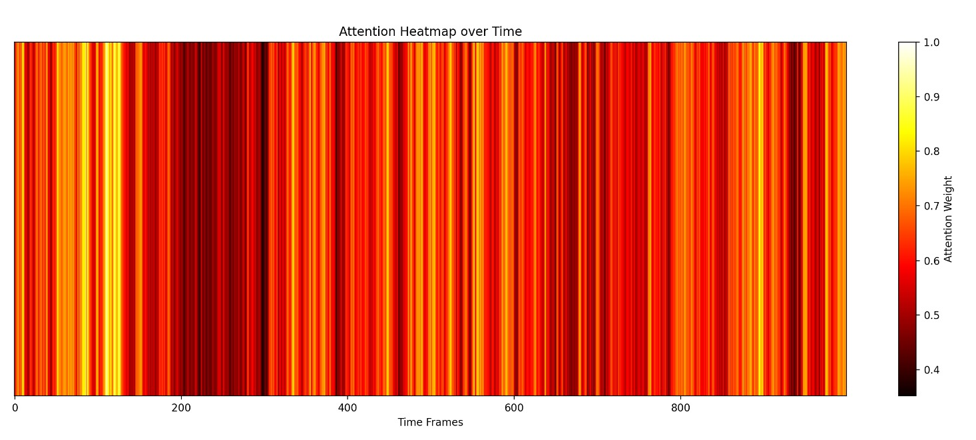
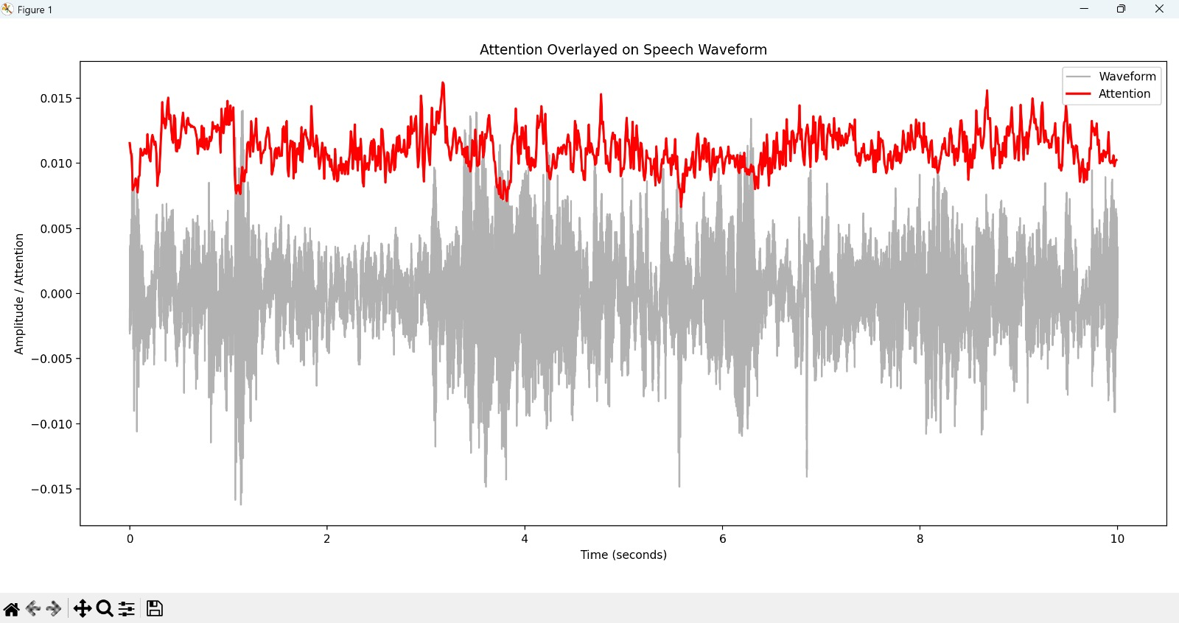
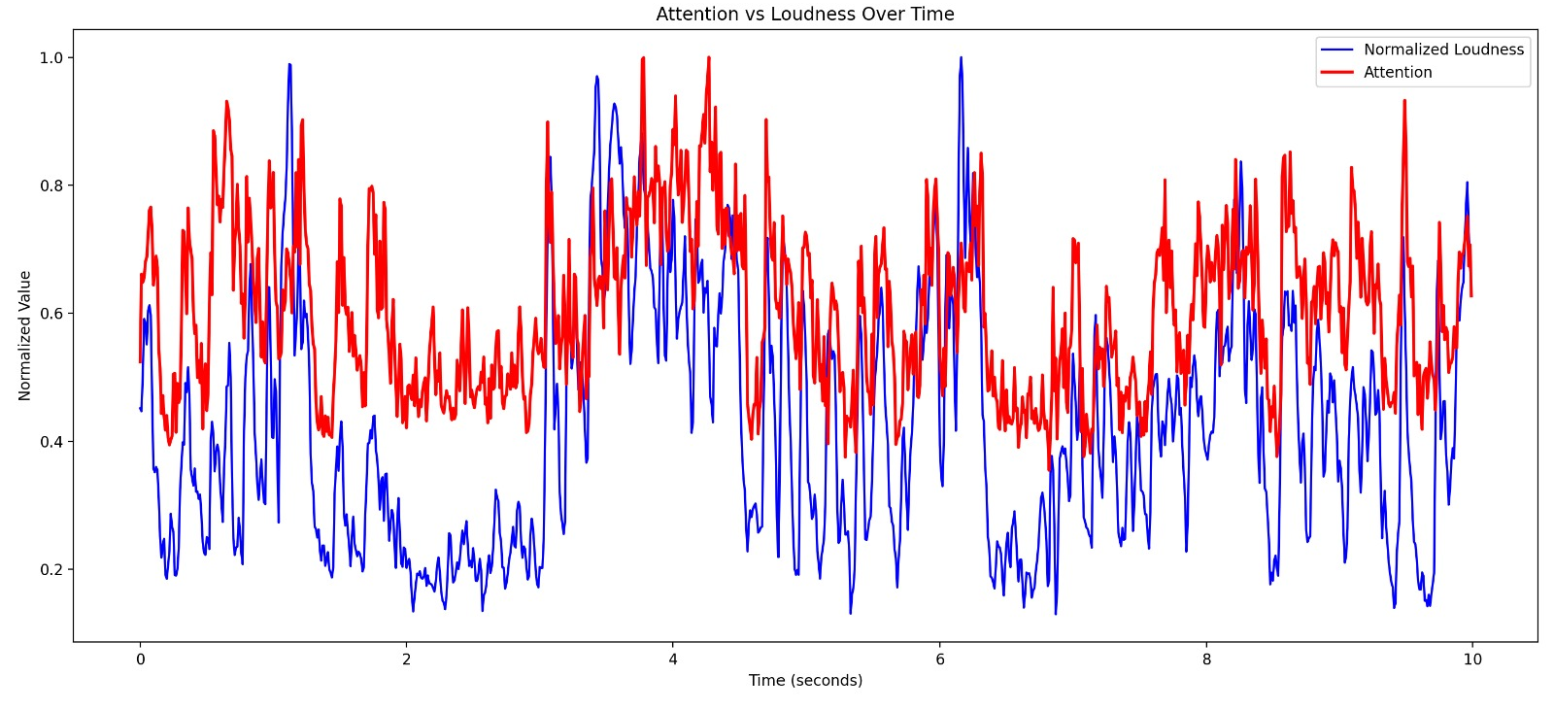
Detecting Depression using vocal cues
Explainability, Visualization & Output Scores
Attention + Speech Waveform Overlay:
Attention does not simply follow loudness
Captures subtle cues (pauses, flat prosody)
Attention Heatmap:
Highlights important time regions
Brighter = higher emotional relevance
Attention vs Loudness:
High attention often aligns with low or irregular energy
Matches known depressive vocal markers

Slide 13
Detecting Depression using vocal cues
Audio Pre-processing & Feature Extraction – Approach 2
AUDIO CLEANING & PRE-PROCESSING
Audio segmentation: Long interview recordings are split into short utterance-level .wav files using timestamp-based cutting.
Audio joining: Relevant speech segments are concatenated to form continuous speech signals.
Noise reduction: Stationary background noise is attenuated using spectral noise profiling.
Amplitude normalization: Gain adjustment (dB increase) is applied to improve signal audibility and consistency.
Format standardization: All audio is converted to a uniform sampling rate and mono channel.
LIBRARIES USED
openSMILE – large-scale acoustic and paralinguistic feature extraction
librosa – audio loading and signal analysis
numpy – numerical operations
scipy – signal processing utilities
noisereduce – background noise suppression
pandas – feature storage and CSV handling
matplotlib – visualization

Slide 14
Detecting Depression using vocal cues
Extracted Features
KEY FEATURE CATEGORIES
PROSODIC FEATURES:
Fundamental frequency (F0): mean, variability
Loudness: mean energy, dynamic range→ Captures flattened intonation and reduced vocal energy
SPECTRAL / CEPSTRAL FEATURES:
MFCCs (1–4): mean and variance
Spectral flux→ Reflects articulation stability and speech dynamics
VOICE QUALITY FEATURES:
Jitter, shimmer
Harmonics-to-Noise Ratio (HNR)→ Indicates vocal instability and breathiness
TEMPORAL SPEECH FEATURES:
Voiced segment rate
Mean voiced/unvoiced duration→ Represents speech rhythm and motor activity

Slide 15
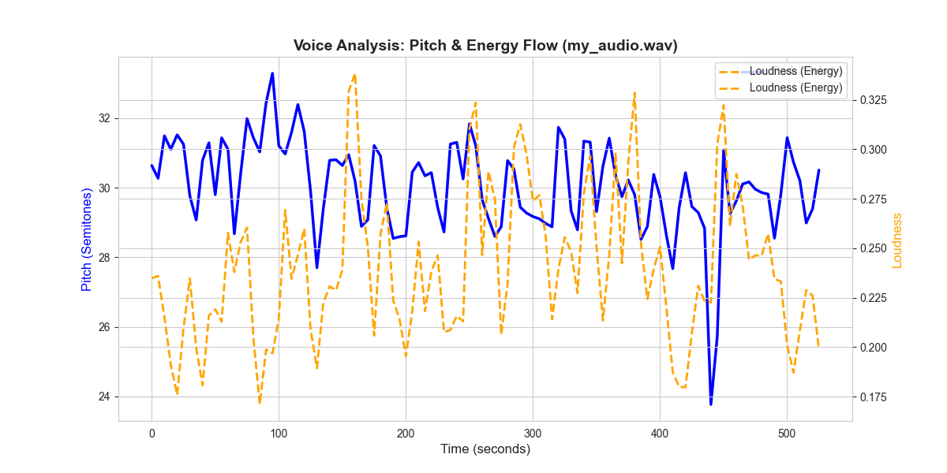
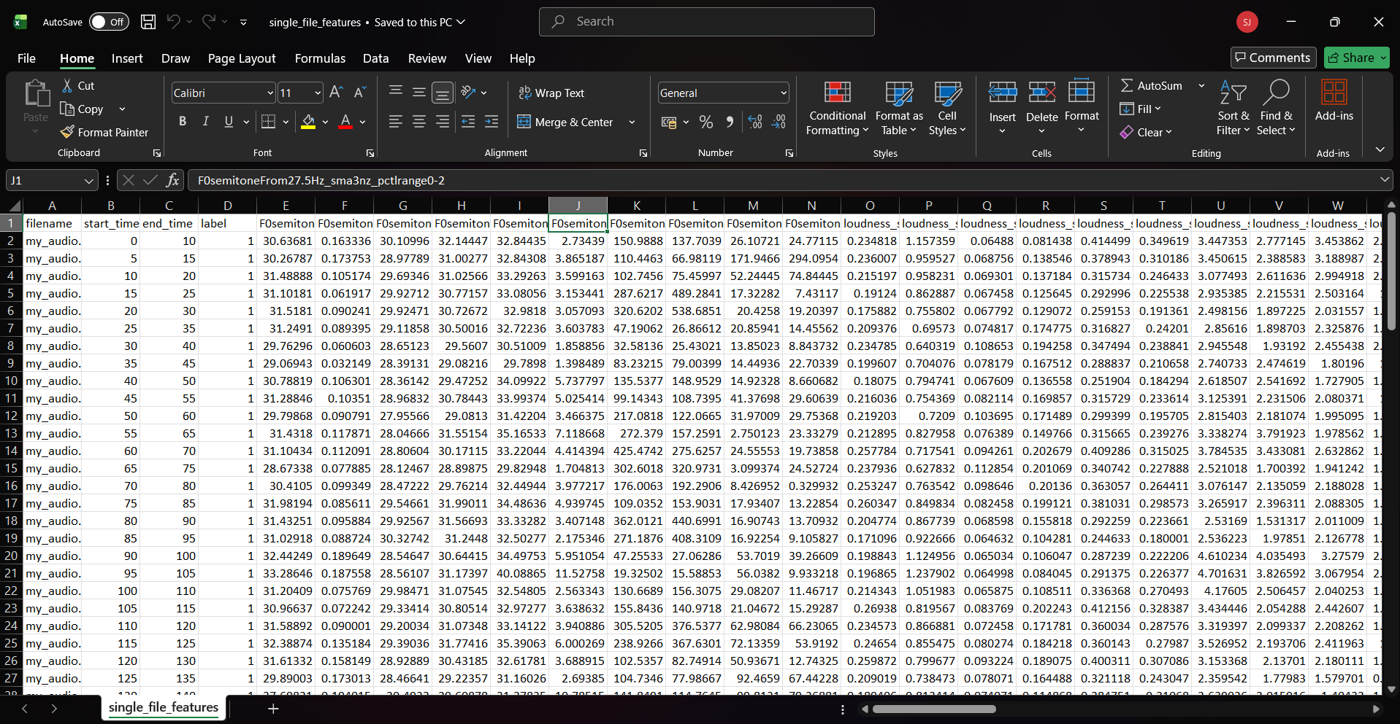
Detecting Depression using vocal cues
Graph & Output Interpretation
The graph shows segment-wise acoustic behavior of the speaker.
Reduced pitch and loudness variability, along with stable MFCC patterns, indicate flattened prosody and reduced expressiveness, which are commonly associated with depressive speech.
The CSV contains numerical acoustic feature values per speech segment, where:
Rows correspond to individual audio segments
Columns represent extracted prosodic, spectral, voice-quality, and temporal features. These values act as input features for machine learning models, not final diagnosis scores.

Slide 16
Detecting Depression using vocal cues
Method-1 vs Method-2: Feature Extraction & Modeling Strategy
ASPECT | METHOD 1: FRAME-LEVEL MFCC + ATTENTION (BASELINE) | METHOD 2: ENHANCED TEMPORAL + EXPLAINABILITY (PROPOSED)
AUDIO CLEANING | BASIC RESAMPLING AND NORMALIZATION | ADVANCED PREPROCESSING: BAND-PASS FILTERING, SNR-BASED NOISE SUPPRESSION, INTERVIEWER (ELLIE) REMOVAL
SAMPLING RATE | 16 KHZ | 16 KHZ (STANDARDIZED ACROSS ALL SUBJECTS)
FEATURE GRANULARITY | FRAME-LEVEL ONLY | FRAME-LEVEL + WINDOW-LEVEL STATISTICS
ACOUSTIC FEATURES USED | MFCC (16), ΔMFCC (16) | MFCC (16), ΔMFCC (16), LOUDNESS (1), LOUDNESS STATISTICS (6)
TOTAL FEATURE DIMENSION | 32 PER FRAME | 33 PER FRAME + TEMPORAL STATISTICS
TEMPORAL MODELING | LSTM WITHOUT EXPLICIT WEIGHTING | LSTM WITH ATTENTION MECHANISM
MODEL FOCUS | TREATS ALL FRAMES EQUALLY | LEARNS WHICH SPEECH SEGMENTS MATTER MOST
EXPLAINABILITY | NONE / LIMITED | ATTENTION HEATMAPS + SHAP FEATURE IMPORTANCE
GRAPH OUTPUTS | PREDICTION CURVES ONLY | ATTENTION HEATMAP, WAVEFORM OVERLAY, ATTENTION VS LOUDNESS
OUTPUT SCORES | BINARY PREDICTION | FRAME-LEVEL PROBABILITY, ATTENTION-WEIGHTED SCORE, SUBJECT-LEVEL CLASSIFICATION
CLINICAL INTERPRETABILITY | LOW | HIGH (ALIGNS WITH KNOWN DEPRESSIVE SPEECH MARKERS)
ROBUSTNESS TO NOISE | MODERATE | HIGH (NOISE-AWARE PREPROCESSING)

Slide 17
Detecting Depression using vocal cues
References
Alghowinem, S., Goecke, R., Wagner, M., Parker, G. and Breakspear, M. (2013) ‘Detecting depression: A comparison between spontaneous and read speech’, IEEE International Conference on Acoustics, Speech and Signal Processing (ICASSP), Vancouver, Canada, pp. 7547–7551.
Cummins, N., Schuller, B., Alghowinem, S., Fonseca, E., Hsiao, R., Lopez-Ojeda, P., Goecke, R. and Breakspear, M. (2015) ‘A review of depression and suicide risk assessment using speech analysis’, Speech Communication, 71, pp. 10–49.
Morales, M.R.A., Levitan, R. and Levitan, S.I. (2018) ‘Speech vs. text: A comparative analysis of features for depression detection systems’, Proceedings of the IEEE Spoken Language Technology Workshop (SLT), Athens, Greece, pp. 136–143.
Valstar, M., Schuller, B., Smith, K., Eyben, F., Jiang, B., Bilakhia, S., Cowie, R. and Pantic, M. (2016) ‘AVEC 2016: Depression, mood, and emotion recognition workshop and challenge’, Proceedings of the ACM International Conference on Multimedia, Amsterdam, The Netherlands, pp. 3–10.
Williamson, J.R., Quatieri, T.F., Helfer, B.S., Horwitz, R. and Yu, B. (2014) ‘Vocal biomarkers of depression based on motor incoordination’, Proceedings of the ACM International Conference on Multimedia, Orlando, FL, USA, pp. 767–770.

Slide 18
Thank You

